Slide 1
Incremental Record Linkage
Anja Gruenheid
ETH Zurich
anja.gruenheid@inf.ethz.ch
Xin Luna Dong
Google Inc.
lunadon@google.com
Divesh Srivastava
AT&T Labs-Research
divesh@research.att.com
Author
Icon
Author
Icon
Author
Icon
Presented By
Abir Bin Ayub Khan
C131001
Spring’13, Dept. of CSE, IIUC
Presented To
Shahidul Islam Khan (Nayeem)
Doctoral Fellow, Dept. of CSE, BUET
Associate Professor, Dept. of CSE, IIUC
01

Slide 2
Overview
1. Introduction
2. Problem Statement
3. Optimal Incremental Solution
4. An Efficient Solution
5. Experimental Evaluation
6. Related Work
7. Conclusion
02

Slide 3
1. Introduction
Clusters Database records
Record linkage
Each cluster represents a single distinct real-world entity
Example- A business, A person
What is Batch Linkage??
2 Challenges of Big Data Era
First
Huge Volume of Data
Record Linkage application takes lot of Time
Francisco
Second
High Velocity of Data Updates
Previous Linkage results gets Obsolete
2 Goals for Incremental Linkage
First
Obtains same or Similar results as Batch Linkage
Second
Significantly Faster execution than Batch Linkage
03

Slide 4
1. Introduction
Incremental
Record
Linkage
1. For each inserted record
2. Compare it with existing clusters
3. Matches with existing Cluster: Put it into that cluster
5. Doesn’t Match? Create a new Cluster
Francisco
Cluster 01 (Existing)
Cluster 02 (Existing)
Cluster 03 (New)
1
2
3
4
5
New Record
6
New Record
7
New Record
04

Slide 5




1. Introduction
2 Questions asked in the paper
When Batch Linkage not General Incremental,
01
Can we do better than just conducting linkage from Scratch?
Francisco
Quality of the Linkage results
02
Vs
Efficiency of the algorithm
05

Slide 6
1. Introduction
3 Contributions
Incrementally maintains a similarity graph
End-to-End solution
for
Incremental record
01
Conducts Incremental graph clustering
Cluster of records referring to same real-world entity
2 optimal clustering algorithms, on the subsets of records
Francisco
Incremental Graph
Clustering
02
Greedy approach to conduct linkage in polynomial time
Instantiate methods on Correlation and DB-Index clustering
03
On real-world data : significantly faster & similar results
06

Slide 7



1. Introduction
Biz ID
ID
name
street address
city
phone
B1
.9
Starbucks
123 MISSION ST STE ST1
SAN FRANCISCO
4155431510
r1
Starbucks
SAN FRANCISCO
4155431510
4 Same
123
MISSION ST STE ST1
1
Starbucks
SAN FRANCISCO
4155431510
B1
r2
Starbucks
123
MISSION ST
SAN FRANCISCO
4155431510
5 Same
Starbucks
123 MISSION ST
SAN FRANCISCO
4155431510
123
MISSION ST
B1
r3
Starbucks
123
Mission St
San Francisco
4155431510
Starbucks
123 Mission St
San
Francisco
4155431510
B2
r4
Starbucks Coffee
340 MISSION ST
SAN FRANCISCO
4155431510
Figure 1(a):
Original business listings
B3
r5
Starbucks Coffee
333 MARKET ST
SAN FRANCISCO
4155434786
D0
B3
r6
Starbucks
MARKET ST
San
Francisco
B4
r7
Starbucks Coffee
52 California St
San
Francisco
4153988630
B4
r8
Starbucks Coffee
52 CALIFORNIA ST
SAN FRANCISCO
4153988630
B5
r9
Starbucks Coffee
295 California St
San
Francisco
4159862349
B5
r10
Starbucks
295 California St
San
Francisco
Explain the red marked records/nodes with Animation – r4,r9
2 Same
0
Starbucks Coffee
295
California St
San Francisco
4159862349
C₁
295
C₄
Starbucks
California St
San
r₄
C₃
r₈
C₂
r₃
.8
r₉
Figure 1(b):
Record Linkage Results
.8
.8
1
1
r₅
r₆
.8
.8
r₂
.9
r₇
C₅
.9
r₁
r₁₀
07
Notes:
Although r9 and r10 these two records belong to the same business entity which we can understand from the Biz ID they did not make a cluster.

Slide 8
4 Same
.9
Starbucks
123
MISSION ST STE ST1
SAN FRANCISCO
4155431510
r1 vs r2
Starbucks
123
MISSION ST
SAN FRANCISCO
4155431510
r2 vs r3
5 Same
1
Starbucks
123
MISSION ST
SAN FRANCISCO
4155431510
Starbucks
123
Mission St
San Francisco
4155431510
Biz ID
ID
name
street address
city
phone
B1
r1
Starbucks
123 MISSION ST STE ST1
SAN FRANCISCO
4155431510
B1
r2
Starbucks
123 MISSION ST
SAN FRANCISCO
4155431510
B1
r3
Starbucks
123 Mission St
San
Francisco
4155431510
B2
r4
Starbucks Coffee
340 MISSION ST
SAN FRANCISCO
4155431510
D0
B3
r5
Starbucks Coffee
333 MARKET ST
SAN FRANCISCO
4155434786
B3
r6
Starbucks
MARKET ST
San
Francisco
B4
r7
Starbucks Coffee
52 California St
San
Francisco
4153988630
B4
r8
Starbucks Coffee
52 CALIFORNIA ST
SAN FRANCISCO
4153988630
B5
r9
Starbucks Coffee
295 California St
San
Francisco
4159862349
B5
r10
Starbucks
295 California St
San
r8 vs r9
3 Same
.8
Starbucks Coffee
52
CALIFORNIA ST
SAN FRANCISCO
4153988630
Starbucks Coffee
295
California St
San
Francisco
4159862349
r9 vs r10
2 Same
0
Starbucks Coffee
295
California St
San Francisco
4159862349
Starbucks
295
California St
San

Slide 9
1. Introduction
 | Biz ID | ID | name | street address | city | phone
∆D1 | B6 | r11 | Starbucks Coffee | 201 Spear Street | San Francisco | 4159745077
∆D2 | B3 | r12 | Starbucks Coffee | MARKET ST | San Francisco | 4155434786
 | B3 | r13 | Starbucks | 333 MARKET ST | San Francisco | 4155434786
∆D3 | B1 | r14 | Starbucks | 123 MISSION ST STE ST1 | SAN FRANCISCO | 4155431510
 | B1 | r15 | Starbucks | 123 Mission St Ste St1 | San Francisco | 4155431510
∆D4 | B5 | r16 | Starbucks | 295 CALIFORNIA ST | San Francisco | 4159862349
 | B4 | r17 | Starbucks | 52 California Street | SAN FRANCISCO SF | 4153988630
Show how r14 will be matched pairwise with all the records in first list
r₄
.8
C₄’’
.8
r₃
C_{2’}’
r₈
1
r₅
r₁₇
.9
r₂
.9
.8
.9
.9
r₁₃
1
r₉
r₁
.9
.9
.9
r₁₆
.8
.9
.9
.9
.8
1
1
.8
C₃
r₇
.8
.9
r₁₂
C₆
.9
C₅’’
r₁₄
.8
1
r₆
r₁₀
C₁’’’
r₁₅
r₁₁
09
Figure 3: Results of a baseline incremental linkage algorithm(Naive Approach)
Notes:
First lets see how r14 and r15 got placed in cluster 1. similarly we can see that r12, r13 have been placed inside cluster C2. r11 did not get the required similarity values to get into any of the existing clusters, so it made its own cluster C6. r16 is placed in C5 cluster and r17 in C4.

Slide 10
1. Introduction
 | Biz ID | ID | name | street address | city | phone
∆D1 | B6 | r11 | Starbucks Coffee | 201 Spear Street | San Francisco | 4159745077
∆D2 | B3 | r12 | Starbucks Coffee | MARKET ST | San Francisco | 4155434786
 | B3 | r13 | Starbucks | 333 MARKET ST | San Francisco | 4155434786
∆D3 | B1 | r14 | Starbucks | 123 MISSION ST STE ST1 | SAN FRANCISCO | 4155431510
 | B1 | r15 | Starbucks | 123 Mission St Ste St1 | San Francisco | 4155431510
∆D4 | B5 | r16 | Starbucks | 295 CALIFORNIA ST | San Francisco | 4159862349
 | B4 | r17 | Starbucks | 52 California Street | SAN FRANCISCO SF | 4153988630
Figure 2(a):
Updates for business listings
r₄
C₁’’
C₄’
.8
r₃
r₈
.8
r₅
C₂’
r₁₇
.9
1
.8
C₅’
r₂
.9
.9
1
.9
r₁₃
.9
r₉
r₁
.9
.9
.9
.8
C₁’’
.8
r₁₆
.9
.9
.8
r₇
1
r₁₂
.8
.8
.9
1
.9
r₁₄
1
r₆
r₁₁
r₁₀
C₁’
r₁₅
08
Figure 2(b): Record linkage results with all updates

Slide 11
Overview
2 Problem Statement
2.1 Problem Definition
2.2 An end-to-end Framework
2.3 Background for Graph Clustering
10

Slide 12




2 Problem Statement
2.1 Problem Definition
Familiarization with Symbols
A set of records
A clustering of records in as record-linkage results
The batch linkage method that obtains on
Increment: Update operations(Insert, Delete, Change) made at the same time
Records in Delete or Change operations already exists in
Is valid
Records in Insert does not exit in
11

Slide 13


2 Problem Statement
2.1 Problem Definition
Legends
Definition 2.1 : INCREMENTAL LINKAGE
A set of records
Clusters records in | based on
A clustering of records in
Denoted by,
Increment to
Goals in Details:
01
Much Faster than , when
02
Quality similar to Batch,
12

Slide 14







2 Problem Statement
2.1 Problem Definition
Legends
for records in
construct
a similarity graph
Each node
represents a record
Each edge
with weight
0 ≤
≤ 1
represents
similarity between records
13

Slide 15

2.1 Problem Definition
Graph Representation
Insert
adding a node & edges to the node
Delete
Removing a node & edges to the node
Change
Remove existing edges & add new edges to the corresponding node
13

Slide 16



2.2 An End-to-End framework
3 steps
Puts records into blocks
Problem: Volume
1
records share same commonality
Recent Blocking Techniques
refer to the same real-world entity
Compute Pairwise similarity of records
2
Constructs Similarity Graph
Problem: Velocity
Our Proposed Approach
Conducts Graph Clustering
3
Same cluster: refers to same entity
Different cluster: refers to different entity
14

Slide 17



2.2 An End-to-End framework
Blocking
Avoids pairwise comparison
Exhaustive
Builds an index for the records
Index
Each index entry forms a block
Block
Index
In Incremental blocking
Inserted record
Deleted record
Changed record
14

Slide 18

2.2 An End-to-End framework
Incremental blocking
Inserted record
“Starbucks”
R1
R2
R3
“Starbucks”
R1
R2
R3
Deleted record
“Starbucks”
R1
R2
R3
R3
“Starbucks”
R1
R2
Changed record
“Starbucks”
R1
“Starbucks”
R1
R2
“KFC”
R3
“KFC”
R2
R3
“KFC”
R3
14

Slide 19
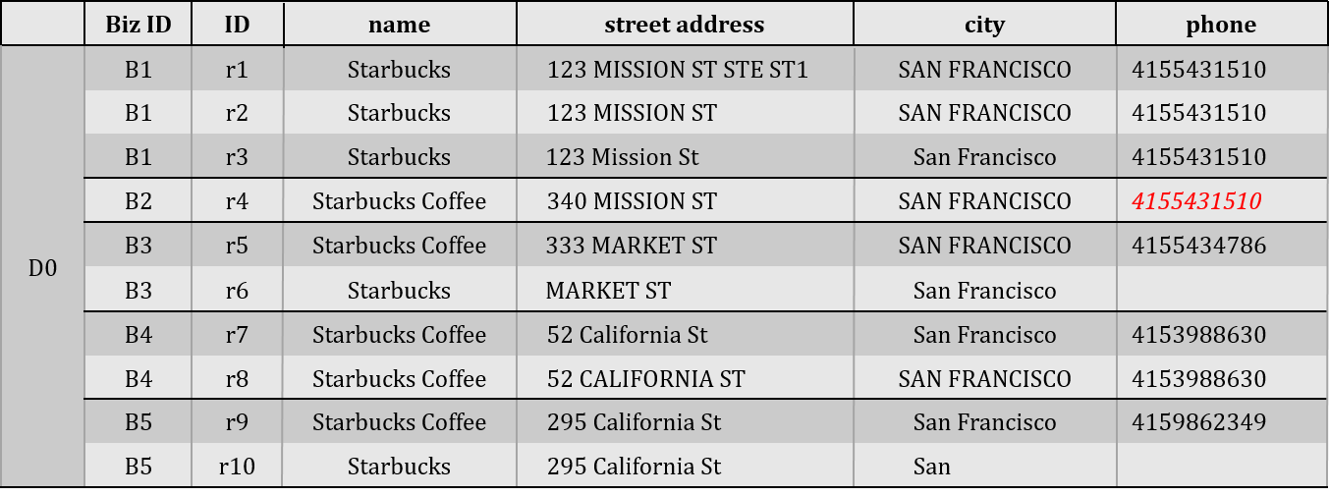
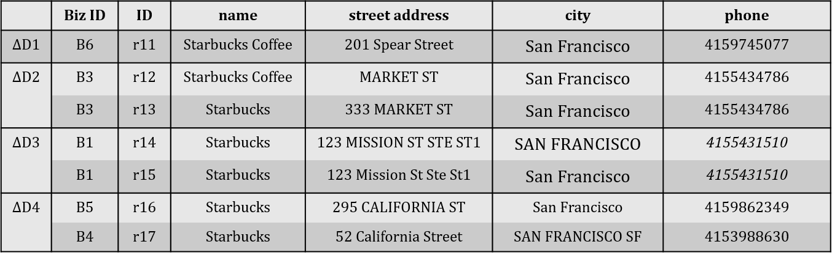
2.2 An End-to-End framework
Incremental blocking
“Starbucks”
Contains all records in Do
“Starbucks”
records in D1-D4
14

Slide 20

2.2 An End-to-End framework
Similarity Computation
Computes
[The changes of an Increment to a graph]
Inserted Node + Associated Edges
Deleted Node + Associated Edges
Changed Edges
14

Slide 21


2.2 An End-to-End framework
Graph Clustering
Re-cluster the nodes according to the changes
Don’t apply clustering on the whole
Apply clustering on Only a subgraph of
Need similar results as Batch Linkage
Design Incremental Clustering According to Batch Clustering Algorithm
14

Slide 22
2.3 Background for graph Clustering
2
Classical clustering methods in record linkage
i
Correlation clustering
ii
DB-Index clustering
Common clustering procedure
Evaluate
Clustering
by an
Objective Function
Choose
Clustering
Optimizes
Value of Objective Function
17

Slide 23


2.3 Background for graph Clustering
Why focus on objective function?
Reward
High Cohesion
Similarity/Closeness of nodes in the same cluster
Penalize
High Correlation
Similarity/Closeness of nodes across different clusters
17

Slide 24



2.3 Background for graph Clustering
Reasons to choose Correlation & DB-Index
Doesn’t require A priori knowledge of Cluster numbers
Example: K-Means clustering
Clustering method
Represents
Category of graph clustering
Correlation clustering
Adjacency-based measures
DB-Index clustering
Distance-based measures
Satisfies general incremental condition
Example- Agglomerative clustering method(Swoosh)
17

Slide 25
2.3 Background for graph Clustering
Correlation clustering
Goal:
Find
A partition of nodes in G
Agrees with
Edge labels
Strategies to achieve goal
01
Maximize
agreements
clustering
Vs
edge Labels
02
Minimize
disagreements
02
Minimize
disagreements
Equivalent but differ in Approximation point of view
Our Focus
17

Slide 26

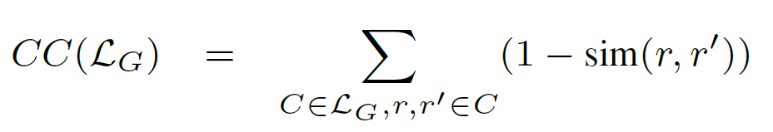
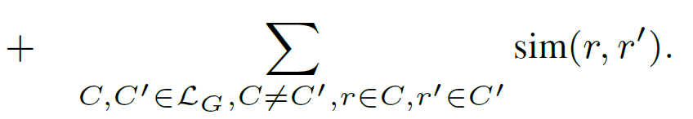
2.3 Background for graph Clustering
Correlation clustering
C₁
Cohesion Penalty
Complement of Similarity
In the same cluster
C₁
C₂
Correlation Penalty
The Similarity
In different clusters
Goal:
Minimize the sum of Penalty
17

Slide 27
2.3 Background for graph Clustering
Correlation clustering
Example 2.3
C₁
C₄
r₄
r₈
.8
r₃
.8
r₉
.8
1
1
.8
.8
.9
.8
r₂
r₇
C₅
.9
r₁
r₁₀
Cohesion Penalty in C1
Cohesion Penalty in C4 and C5
C₁
C₄
C₅
1-
+
1-
+
1-
+
1-
+
1-
.2
+
.2
+
0
=
0.4
.2
+
.2
+
.1
+
.1
+
0
Correlation Penalty in C4 and C5
C₄
C₅
0.6
17

Slide 28
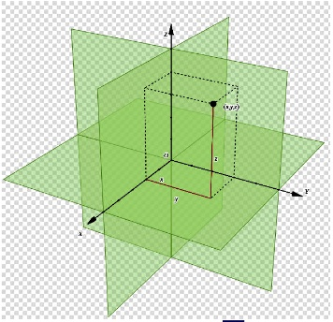


2.3 Background for graph Clustering
DB-Index clustering
Davis-Bouldin Index
Originally for
Euclidean Space
For record linkage application
Definition of distance
is adjusted
Complement of
Average similarity
Between records
Same cluster
Intra-Cluster Distance
Complement of
Average similarity
Between records
Inter-Cluster Distance
Across clusters
17

Slide 29






2.3 Background for graph Clustering
DB-Index clustering
Separation Measure
and Small numbers such that denominators/nominators affect the result even when either of them is 0
For each cluster
C₂’
C₃’
C₁
C₃’
C₁
C₄’
DB-Index for all clusters
C₁
C₂
C₃
M(C₁)+ M(C₂)+ M(C₃)
3
17

Slide 30
2.3 Background for graph Clustering
DB-Index clustering
Example 2.4
C₁
C₄
r₄
r₈
.8
r₃
.8
r₉
.8
1
1
.8
.8
.9
.8
r₂
r₇
C₅
.9
r₁
r₁₀
Intra-cluster distance
C₁
1 – Avg{0.8, 0.8, 0.9, 0.9, 1, 0}
= 1 – 0.73
= 0.27
C₄
1 – Avg{0.8, 0.8, 1}
= 1 – 0.87
= 0.13
C₂
C₃
C₅
C₂
0
C₃
0
C₅
0
r₅
r₁₀
r₆
17

Slide 31
2.3 Background for graph Clustering
DB-Index clustering
Example 2.4
R10-r9
R10-r8
Inter-cluster distance
R10-r7
C₄
r₈
C₄ – C₅
1 – Avg{0.8, 0, 0}
= 1 – 0.27
= 0.73
.8
r₉
1
.8
.8
r₇
C₅
For all other cluster pairs
No more crossing cluster pairs available
r₁₀
C₁ – C₂
C₂ – C₁
C₃ – C₁
C₄ – C₁
C₅ – C₁
C₁ – C₃
C₂ – C₃
C₃ – C₂
C₄ – C₂
C₅ – C₂
1
C₁ – C₄
C₂ – C₄
C₃ – C₄
C₄ – C₃
C₅ – C₃
C₁ – C₅
C₂ – C₅
C₃ – C₅
17

Slide 32
2.3 Background for graph Clustering
DB-Index clustering
Example 2.4
For C₄
D(C₄) + D(C₅) +
0.13 + 0+ 0.01
M(C₄, C₅) =
=
= 0.19
D(C₄, C₅) +
0.73 + 0.001
D(C₄)+ D(C₁)+
0.13 + 0.27 + 0.01
M(C₄, C₁) =
=
= 0.41
D(C₄, C₁) +
1 + 0.001
D(C₄)+ D(C₂)+
0.13 + 0 + 0.01
M(C₄, C₂) =
=
= 0.14
D(C₄, C₂) +
1 + 0.001
D(C₄)+ D(C₃)+
0.13 + 0 + 0.01
M(C₄, C₃) =
=
= 0.14
D(C₄, C₃) +
1 + 0.001
17

Slide 33
2.3 Background for graph Clustering
DB-Index clustering
Example 2.4
For C₄
M(C₄) = max {M(C₄, C₅), M(C₄, C₁) , M(C₄, C₂), M(C₄, C₃) }
M(C₄) = max {0.19, 0.41, 0.14, 0.14}
M(C₄) = 0.41
DB-Index for all clusters
For C₁
M(C₁) = 0.41
Avg{M(C₁) , M(C₂), M(C₃), M(C₄), M(C₅) }
= Avg{0.41, 0.28, 0.28, 0.41, 0.28}
= 0.332
For C₂
M(C₂) = 0.28
For C₃
M(C₃) = 0.28
For C₅
M(C₅) = 0.28
17

Slide 34
Overview
3 Optimal Incremental Solution
3.1 Desirable Properties of linkage
3.2 Connected component Algorithm
3.3 Iterative Algorithm
18

Slide 35







3.1 Desirable Properties of linkage
Definition 3.1 : CONNECTIVITY
Legends
C₀
A clustering of G
Objective function in graph clustering
Optimal clustering of G according to O
- A Clustering
- Put 2 disconnected clusters
- In into the same cluster
C₀
C₀’
C₀’’
Our Aim
Minimize the value of
satisfies connectivity
Without losing Generality
for every such and
19

Slide 36


3.1 Desirable Properties of linkage
Definition 3.2 : LOCALITY
Legends
G1 and G2
Split of G
G
Optimal clustering of G1 according to O
Optimal clustering of G2 according to O
G1
G2
G1
G2
satisfies locality
Forms optimal clustering for G under O
19

Slide 37
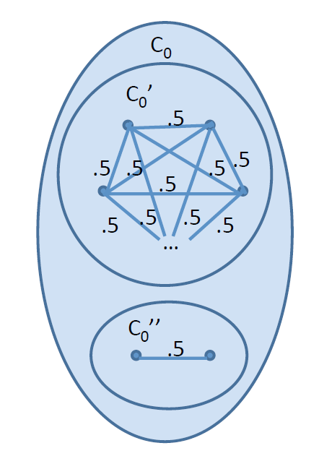
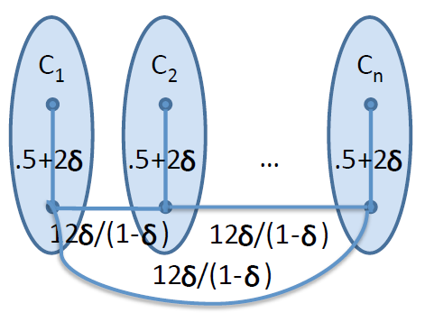

3.1 Desirable Properties of linkage
Example 3.3
Figure 5:
An example illustrating that DB-Index violates the desired graph clustering properties
n+1 clusters
n+2 clusters
2 subgraphs C₀’ and C₀’’
C₀’ has m nodes
2 clusters C₀’ and C₀’’
satisfies connectivity
When better than
19

Slide 38







3.1 Desirable Properties of linkage
Example 3.3
Intra-cluster distance of
When m is large
+ve number
Close to 0
Intra-cluster distance of
19

Slide 39






3.1 Desirable Properties of linkage
Example 3.3
Inter-cluster distance of
Inter-cluster distance of
Assumed for simplicity
Same conclusion
19

Slide 40






3.1 Desirable Properties of linkage
Example 3.3
Separation Measure for
DB-Index for
Same
Split into
DB-Index for
Is better than
Optimal clustering
satisfies connectivity
When better than
DB-Index violates connectivity and locality
19

Slide 41
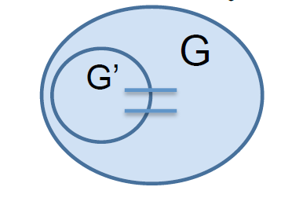



3.1 Desirable Properties of linkage
Definition 3.1 : EXCHANGEABILITY
Legends
A subset of clusters
Subgraph containing only nodes in
satisfies EXCHANGEABILITY
For every such
Optimal clustering for
Replacing
With any other optimal clustering of
Obtains an optimal clustering for
under
19

Slide 42


3.1 Desirable Properties of linkage
Definition 3.1 : EXCHANGEABILITY
Example 3.6: EXCHANGEABILITY
Optimal clustering contains
if EXCHANGEABILITY holds
Should be Optimal clustering for
However, Actually
Figure 5
and DB-Index
Optimal clustering for
DB-Index violates EXCHANGEABILITY
19

Slide 43

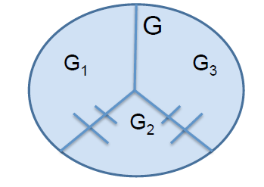







3.1 Desirable Properties of linkage
Definition 3.1 : SEPARABILITY
Are partitions of
Are disconnected
Optimal clustering for
With no cluster across
Optimal clustering for
With no cluster across
satisfies EXCHANGEABILITY
For every such
There exists an Optimal clustering for
With no cluster across 2 or three of the subgraphs
under
19

Slide 44








3.1 Desirable Properties of linkage
Example 3.6: SEPARABILITY
Consider splitting
Are disconnected
Figure 5
and DB-Index
Optimal clustering for
Optimal clustering for
However, Actually
Optimal clustering for
Contains cluster
DB-Index violates SEPARABILITY
19

Slide 45


3.1 Desirable Properties of linkage
Definition 3.7 : MONOTONICITY
Legends
Two nodes in the same cluster in
+ve
A graph obtained by Increasing the weight of edge
-ve
A graph obtained by decreasing the weight of edge
For every such
and
Satisfies Positive MONOTONICITY
Is also Optimal clustering of
+ve
Satisfies Negative MONOTONICITY
Is also Optimal clustering of
-ve
Satisfies Positive MONOTONICITY
Satisfies Positive MONOTONICITY
Satisfies Negative MONOTONICITY
&
21

Slide 46

3.1 Desirable Properties of linkage
connectivity
THEOREM 3.8 :
locality
locality implies connectivity
exchangeability
monotonicity
exchangeability implies locality
separability
separability implies locality
an objective function exists that satisfies exchangeability but not separability and vice versa
an objective function exists that satisfies connectivity
but not monotonicity and vice versa
22

Slide 47


3.1 Desirable Properties of linkage
THEOREM 3.9 :
DB-Index does not satisfy any of the five properties
Objective function of
Correlation clustering satisfies the five properties
connectivity
connectivity
locality
locality
exchangeability
exchangeability
separability
separability
monotonicity
monotonicity
22

Slide 48
3 Optimal Incremental Solution
3.1 Desirable Properties of linkage
Is it really Optimal?
First
Defined Objective function
Objective function used in Clustering method
Objective function not applied on clustering algorithm F
Not General Incremental
Incremental linkage algorithm design possible
Second
defined properties are met
An optimal solution
Properties don’t hold
High Quality linkage results generation possible
23

Slide 49



3 Optimal Incremental Solution
3.2 Connected component Algorithm
Definition 3.11 : CONNECTED COMPONENT
Legends
A similarity Graph
An increment on
Connected component of
Transitive closure of a node
Connected subgraph in
The node
Transitive closure of an edge
Connected subgraph in
The edge
Inserted
Union of Transitive closures for each
Deleted
Node or Edge
Changed
02

Slide 50



3 Optimal Incremental Solution
3.2 Connected component Algorithm
Legends
Definition 3.12 : MONOTONE CONNECTED COMPONENT
A similarity Graph
Monotone Connected Component of
Optimal clustering on
Is defined as follows:
An increment on
Contains
node
Inserted
Transitive closure of
node
Deleted
Cluster of
in
edge
Increased Weight
Transitive closure of
// across clusters in
edge
Decreased Weight
// across clusters in
Transitive closure of
02

Slide 51
3 Optimal Incremental Solution
3.2 Connected component Algorithm
Algorithm : CONNECTED
3 steps
1
Find the connected component of
Legends
Find the optimal clustering on
A similarity Graph
2
Optimal clustering on
3
Construct the new clustering from
An increment on
By replacing old clusters for
With new optimal clusters
Algorithm : MONOCONNECTED
CONNECTED + Monotone Connected Component
02

Slide 52







3 Optimal Incremental Solution
3.2 Connected component Algorithm
Example: 3.13
Consider
Inserts
+ associated edges
C₄’
Transitive closure of
r₈
r₁₇
.9
Transitive closure of
C₅’
.8
.9
1
Connected component for
r₉
A subgraph with nodes
.8
.9
r₇
r₁₆
.8
.9
New clusters
replace Old
r₁₀
02

Slide 53


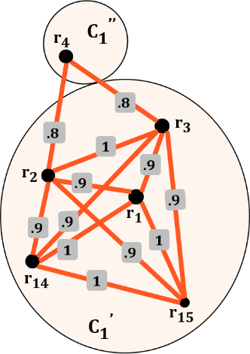

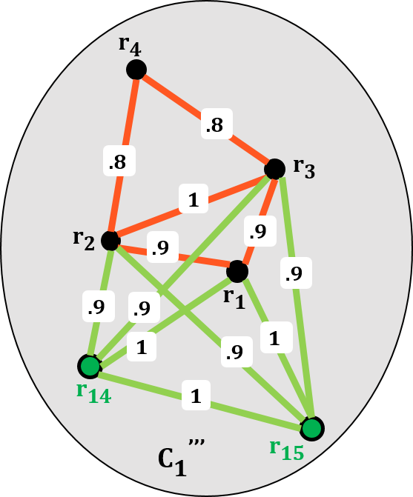
3 Optimal Incremental Solution
3.2 Connected component Algorithm
Example: 3.13
Consider
removes
same
same
Transitive closure of
contains
Algorithm : CONNECTED
Applies clustering on
Result: Obtains same cluster as before
old
new
Algorithm : MONOCONNECTED
Simply removes
Result: Obtains new cluster
02

Slide 54


3 Optimal Incremental Solution
3.2 Connected component Algorithm
LEMMA 3.14
Algorithm CONNECTED is optimal if and only if locality holds
THEOREM 3.15 (OPTIMALITY OF MONOCONNECTED)
Algorithm MONOCONNECTED is optimal if and only if locality and monotonicity holds
COROLLARY 3.16
MONOCONNECTED is optimal for correlation clustering but not for DB-Index clustering
PROPOSITION 3.17 (COMPLEXITY OF MONOCONNECTED)
where is the complexity of finding the optimal clustering on
02

Slide 55




3.3 Iterative Algorithm
Definition 3.18 : DIRECTLY CONNECTED COMPONENT
directly connected component of
Contains
node
Inserted
+ Connected Clusters in
node
Deleted
Cluster of
in
-
- edges to
edge
Increased Weight
// across
edge
Decreased Weight
// within
02

Slide 56
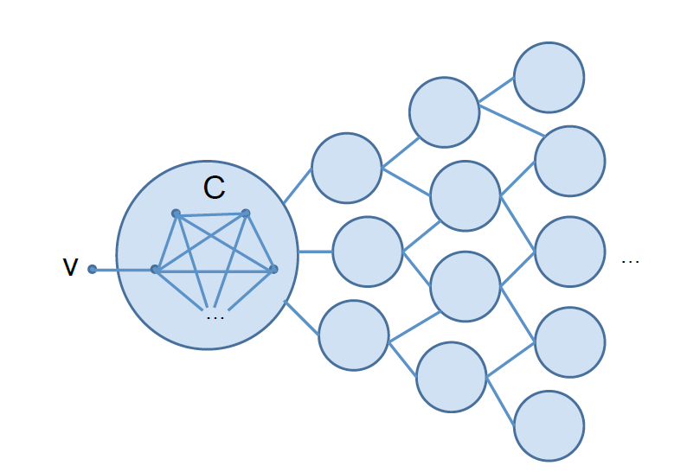

3.3 Iterative Algorithm
Example: 3.19
Consider
Inserts
connected to
connected to
DIRECTLY CONNECTED COMPONENT contains
DIRECTLY CONNECTED COMPONENT contains
and neighbor cluster
MONOTONE CONNECTED COMPONENT contains
the whole graph
02

Slide 57


3.3 Iterative Algorithm
Algorithm : ITERATIVE
Obtain
01
Put each of its connected subgraphs into queue
For -> dequeuer it
Find optimal cluster
02
Exists in the previous clustering
Find Directly Connected Component
03
Never added to
Go over
Find Subgraphs connected or Overlapping with
Remove the Subgraphs from
Merge them with
Repeat until no such subgraphs remain
Add new
to
04
Repeat steps 2-3 until is empty
02

Slide 58

3.3 Iterative Algorithm
Algorithm : ITERATIVE
PROPOSITION 3.20 (COMPLEXITY OF ITERATIVE)
THEOREM 3.21 (OPTIMALITY OF ITERATIVE)
Optimal if and only if exchangeability, separability and monotonicity holds
COROLLARY 3.22
Optimal for Correlation clustering but not optimal for DB-Index clustering
02

Slide 59
Overview
4 An Efficient Solution
4.1 Greedy algorithm
4.2 Instantiation for correlation clustering
02

Slide 60

4 An Efficient Solution
Greedy Algorithm
GOAL:
Algorithm should take polynomial time
Although iteratively expands subgraphs
Clustering in each later round should be built upon the previous rounds’ clustering
ITERATIVE
GREEDY
Working queue
Working queue
Queue stores subgraphs
Stores clusters
Each Iteration :
Batch Clustering on subgraphs
Each cluster:
Adjust nodes between it and neighboring clusters
02

Slide 61




4.1 Greedy Algorithm
For each neighbor cluster
01
Evaluate merging
generates better result
MERGE
02
Better clustering found
(1)
Merge
(2)
Add
(3)
Remove from if
02

Slide 62
4.1 Greedy Algorithm
EXAMPLE
02

Slide 63

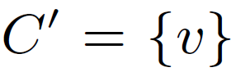



4.1 Greedy Algorithm
For each node
01
Evaluate Splitting
out generates better clustering
02
Found a node
Create a new cluster
Conduct Steps 3-4
SPLIT
03
For each remaining node
Evaluate moving obtains better clustering
if so, move and repeat steps 3
04
Add to if they are connected to other clusters
02

Slide 64
4.1 Greedy Algorithm
For each neighbor cluster
01
do steps 2-3
02
For each node connected to
For each node connected to
MOVE
Evaluate moving to other clusters generates better result
upon finding such node, move it to the other cluster
03
Repeat step 2 until there is no more node to move
(1)
add the two new clusters to
(2)
dequeuer if
02

Slide 65
4.1 Greedy Algorithm
Algorithm 1
For each neighbor cluster
01
do steps 2-3
02
For each node connected to
For each node connected to
MOVE
Evaluate moving to other clusters generates better result
upon finding such node, move it to the other cluster
03
Repeat step 2 until there is no more node to move
(1)
add the two new clusters to
(2)
dequeuer if
02

Slide 66
4 An Efficient Solution
4.2 Instantiation for correlation clustering
02

Slide 67
Overview
5. Experimental Evaluation
5.1 Experimental Setup
5.2 Experiments on Biz
5.3 Experiments on Cora
5.4 Experiments on Febrl
02

Slide 68
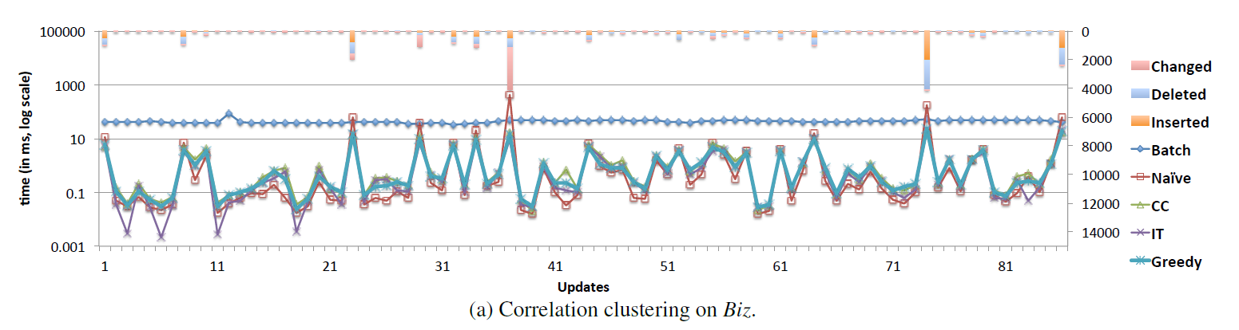
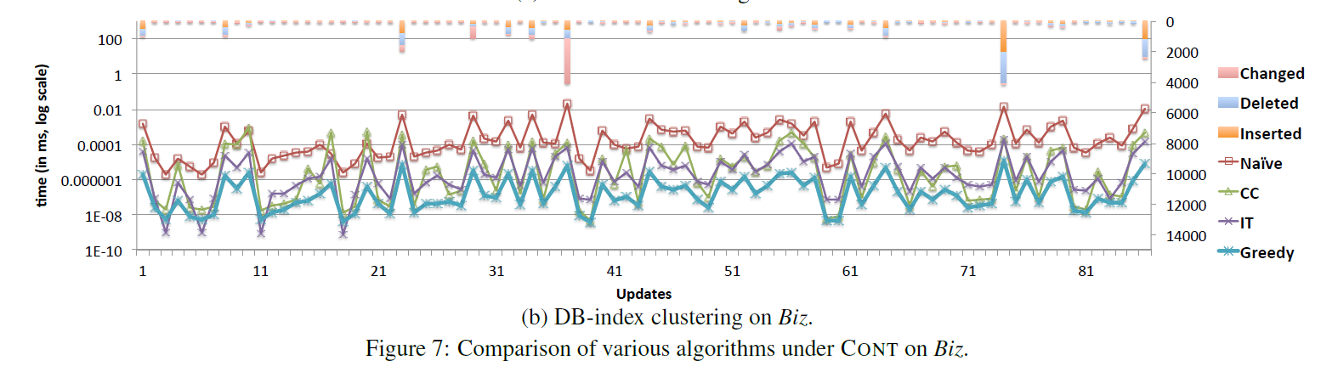
5.1 Experimental Setup
02

Slide 69
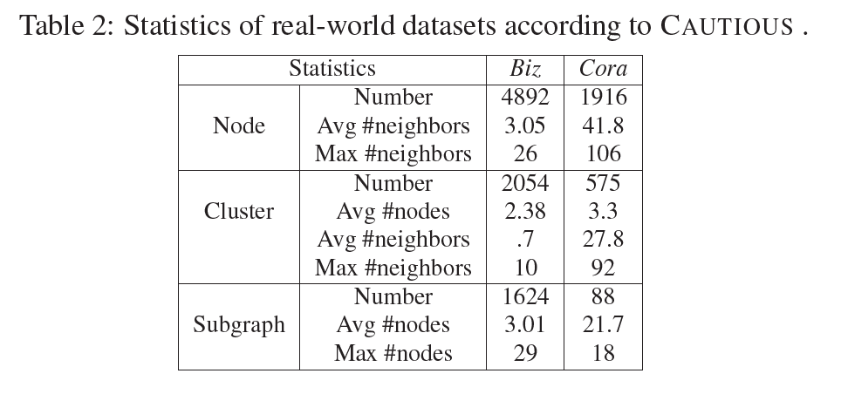
5.1 Experimental Setup
02

Slide 70
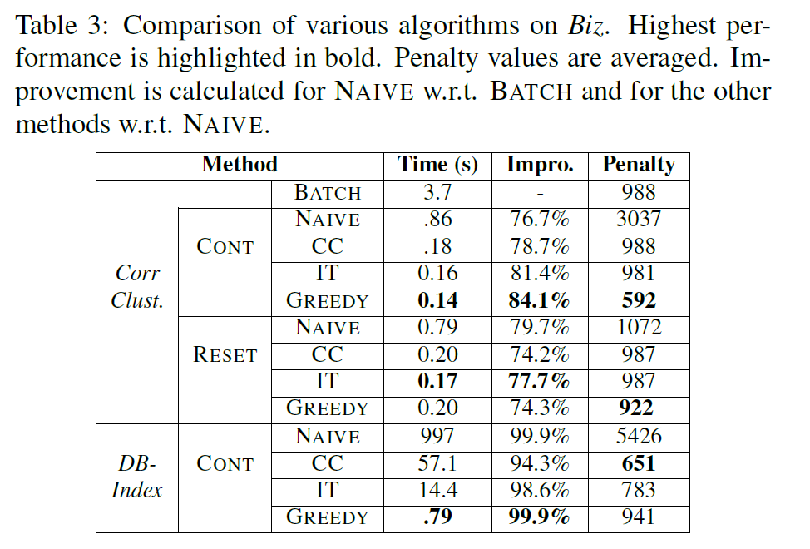
5.2 Experiments on Biz
02

Slide 71
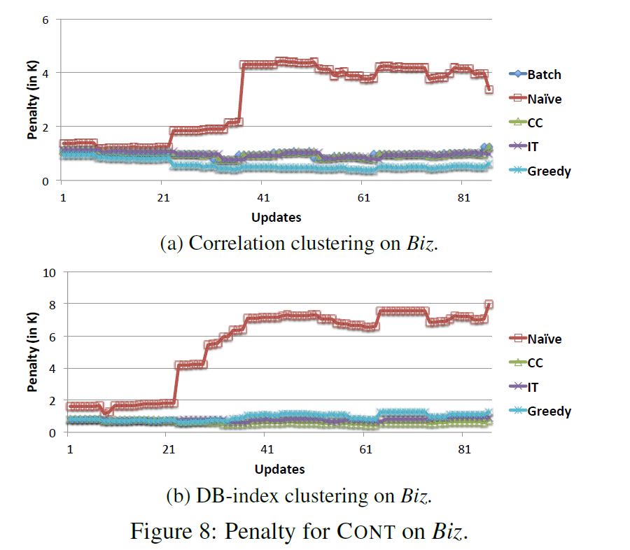
5.2 Experiments on Biz
02

Slide 72
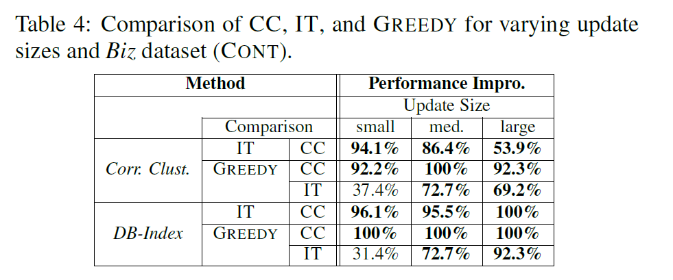
5.2 Experiments on Biz
02

Slide 73
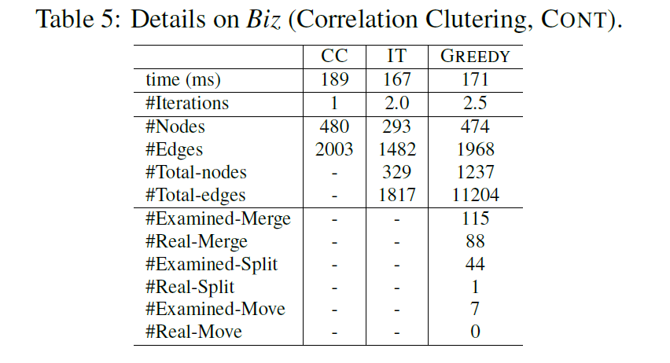
5.2 Experiments on Biz
02

Slide 74
5.3 Experiments on Cora
Algorithm 1
For each neighbor cluster
01
do steps 2-3
02
For each node connected to
For each node connected to
MOVE
Evaluate moving to other clusters generates better result
upon finding such node, move it to the other cluster
03
Repeat step 2 until there is no more node to move
(1)
add the two new clusters to
(2)
dequeuer if
02

Slide 75
5.4 Experiments on Febrl
Algorithm 1
For each neighbor cluster
01
do steps 2-3
02
For each node connected to
For each node connected to
MOVE
Evaluate moving to other clusters generates better result
upon finding such node, move it to the other cluster
03
Repeat step 2 until there is no more node to move
(1)
add the two new clusters to
(2)
dequeuer if
02

Slide 76
Questions
Are Welcome
00

Slide 77
Thank
You
00

